Slide 1

Regression and Classification
Presented by
Mrs. Sujeeta S. Shah
6th Sept. 2025
Department of Computer Science and Engineering(AIML&DS)
AcademicYear - 2024-25

Slide 2
Contents:
Regression
Simple linear regression
Multiple linear regression
Assumptions in regression analysis
Other regression techniques
Improving the accuracy of the linear regression model
Polynomial regression model
Logistic regression
Support Vector Machines
Decision Trees
Definition, terminology, the need, advantages, and limitations
Constructing and understanding decision trees
Common problems with decision trees
Decision tree algorithms – ID3, Random Forest
Examples
Cross-validation
Confusion matrix
Precision–recall

Slide 3
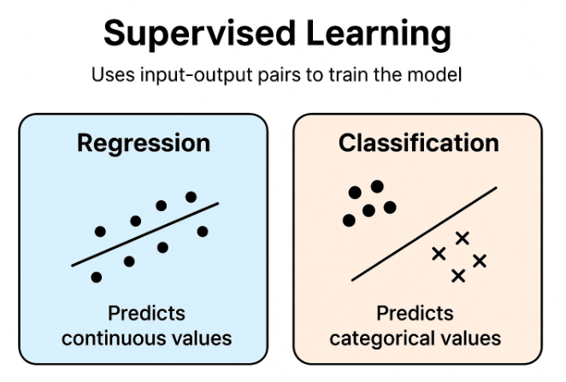
1. Introduction
In Machine Learning (ML), computers learn from data and make predictions or decisions without being directly programmed.
Supervised Learning is the most common type — it uses input–output pairs to train the model. There are two main types of Supervised Learning:
Regression
Classification

Slide 4
Basic Idea
Concept | Question it Answers | Type of Output
Regression | “How much?” or “What value?” | Continuous value (numbers)
Classification | “Which type?” or “Yes/No?” | Category or class

Slide 5
Regression (Prediction of Continuous Values)
Definition:
Regression is a supervised learning technique used to predict a continuous output variable (numeric value) based on one or more input variables.
Example
Example | Input (X) | Output (Y)
Predicting engine temperature | Speed, load, coolant flow | Temperature (°C)
Predicting material stress | Force applied, cross-section | Stress (MPa)
Predicting fuel consumption | Engine speed, torque | Liters/hour

Slide 6
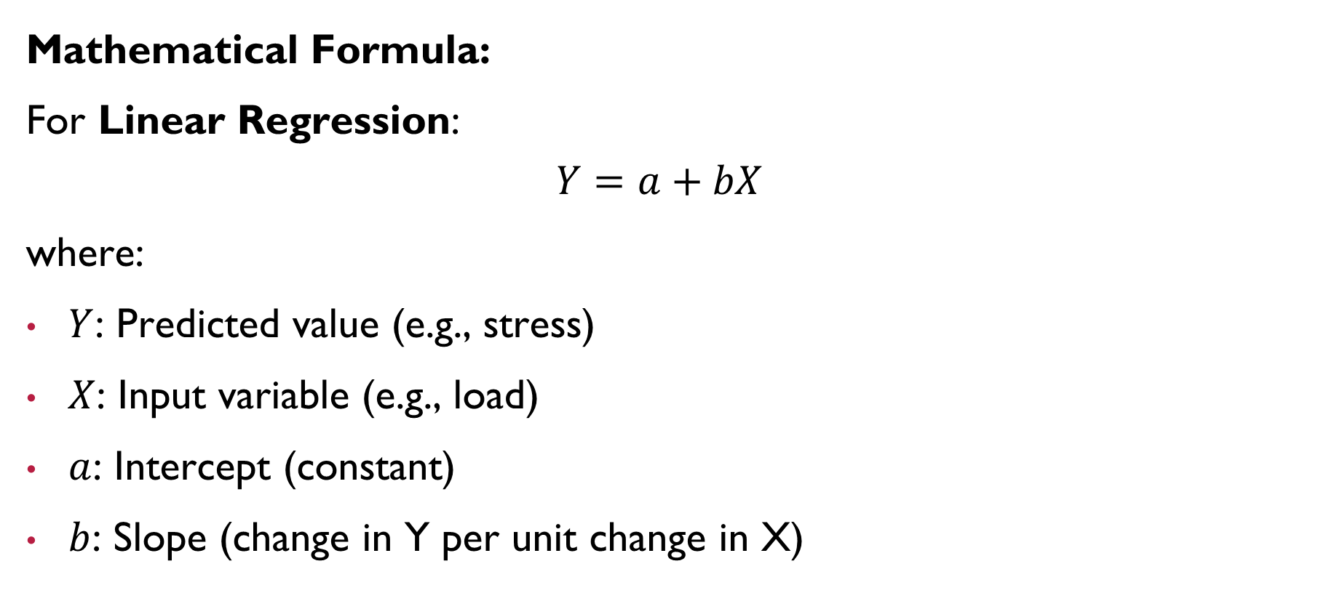

Slide 7
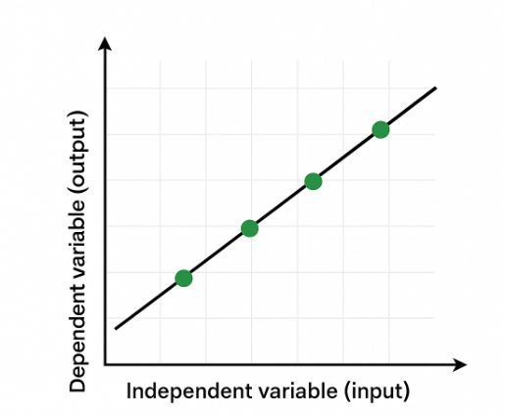
Example: Predicting temperature as speed increases

Slide 8
Classification (Prediction of Categories)
Definition:
Classification is used when the output belongs to a specific category or class — not a number.
Example
Example | Input (X) | Output (Y)
Predicting machine condition | Vibration, sound, temperature | “Normal” or “Faulty”
Identifying metal quality | Composition data | “Good” or “Poor”
Safety test result | Pressure, temperature | “Pass” or “Fail”

Slide 9
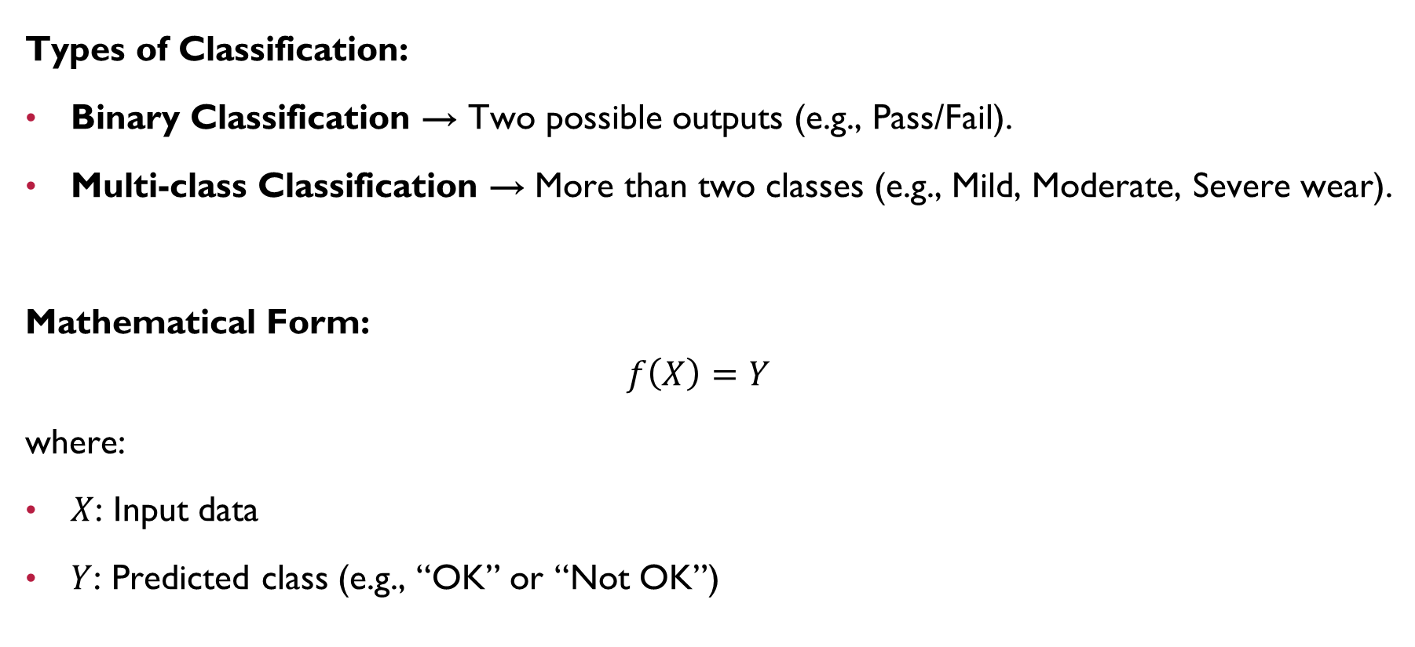

Slide 10
Key Differences Between Regression & Classification
Feature | Regression | Classification
Output | Continuous (numeric) | Discrete (category)
Example | Predicting stress in a beam | Predicting beam failure (Yes/No)
Graph | Line or curve fitting | Decision boundaries
Evaluation | Mean Square Error (MSE), R² | Accuracy, Precision, Recall
Algorithms | Linear Regression, Polynomial Regression | Logistic Regression, Decision Tree, SVM

Slide 11
Real-Life Applications
Domain | Regression Example | Classification Example
Manufacturing | Predicting tool wear | Detecting defective parts
Thermal Systems | Predicting temperature | Detecting overheating risk
Vehicle Engineering | Predicting fuel usage | Predicting brake failure
Maintenance | Predicting machine life | Predicting failure type

Slide 12
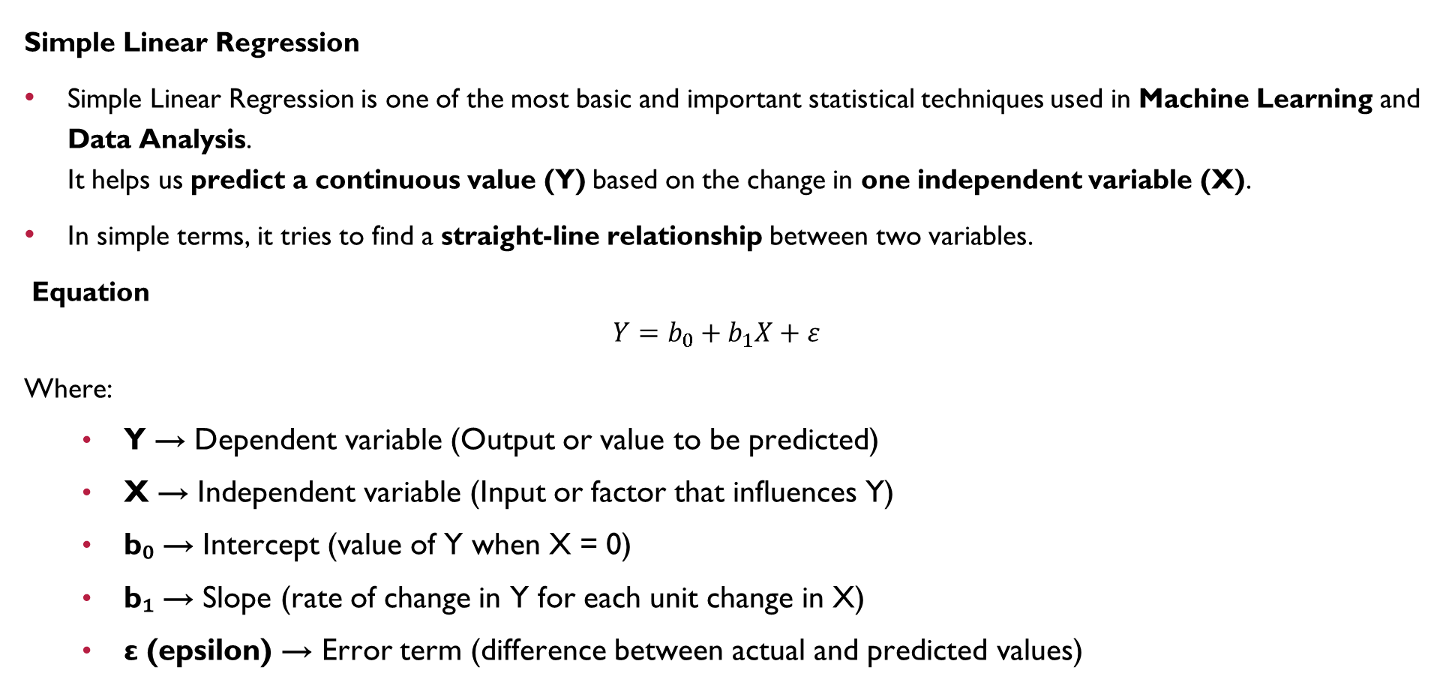
Regression

Slide 13
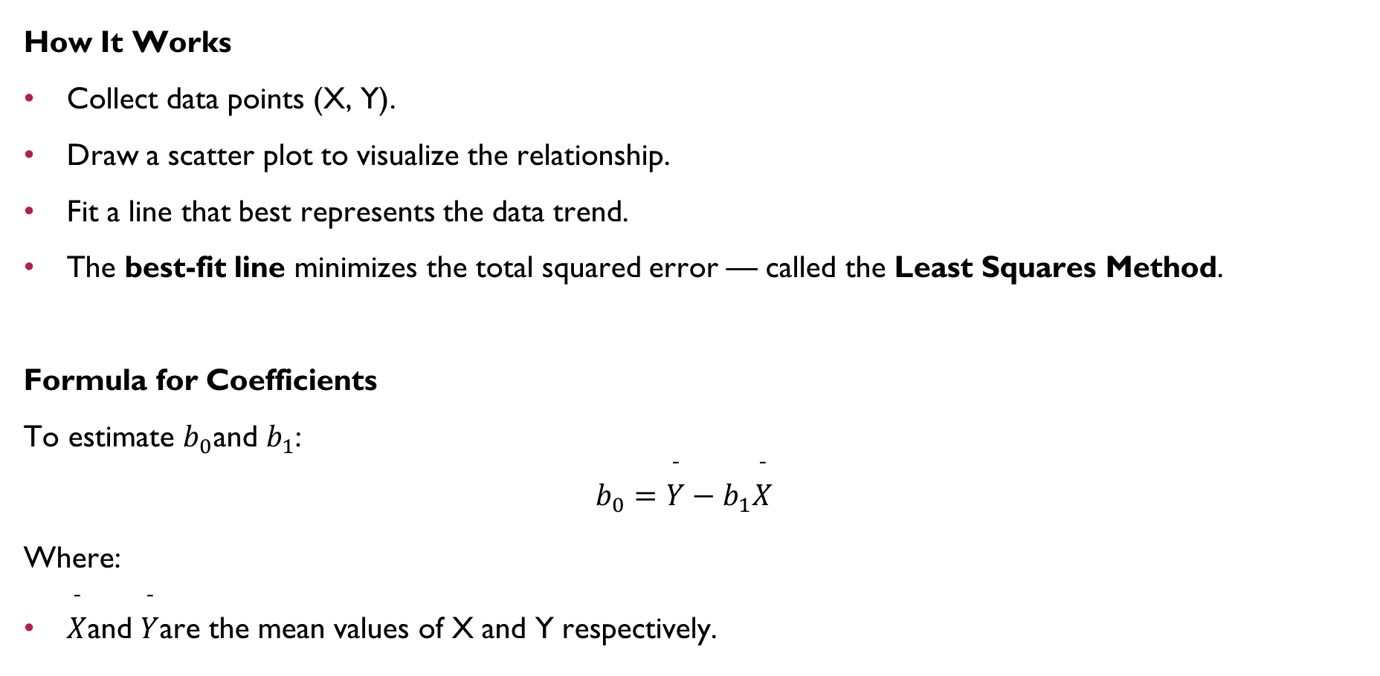

Slide 14
Example
Objective: Predict fuel consumption (Y) of an engine based on engine speed (X).
After applying regression:
Y=1.5+0.002XY = 1.5 + 0.002XY=1.5+0.002X
Interpretation:
For every 1000 RPM increase in engine speed, fuel consumption increases by approximately 2 L/hr.
Engine Speed (RPM) | Fuel Consumption (L/hr)
1000 | 3.2
1500 | 4.5
2000 | 5.1
2500 | 6.0
3000 | 6.8

Slide 15
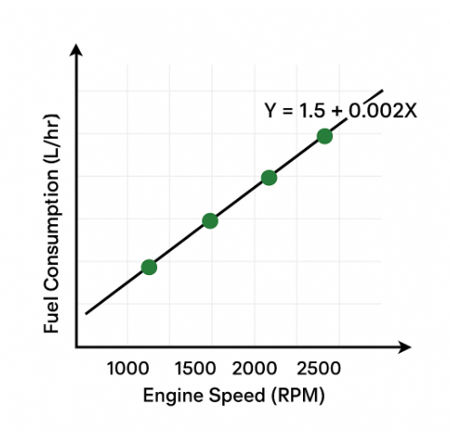
The closer the data lies to the line, the better the regression model.

Slide 16
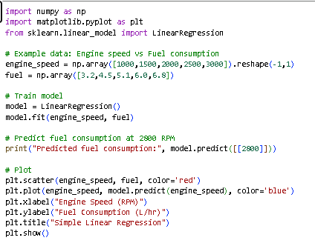
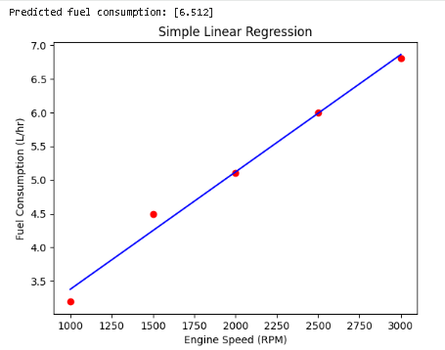
Example: Predicting fuel consumption (Y) based on engine speed (X).

Slide 17
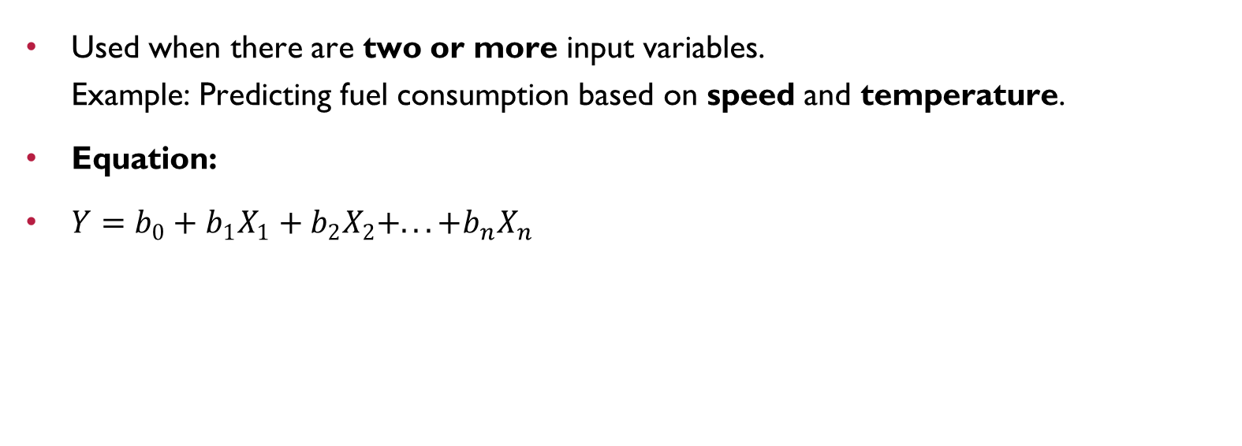
Multiple Linear Regression

Slide 18
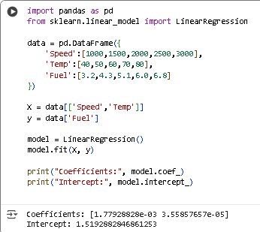
The model calculates the effect of both temperature and speed on fuel consumption.

Slide 19
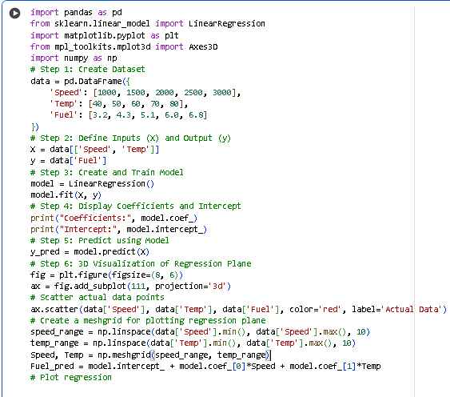
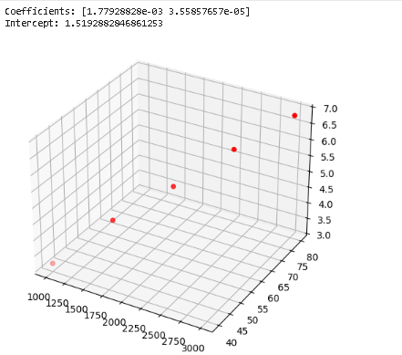

Slide 20
Applications in Mechanical Engineering
Predicting tool wear based on cutting time.
Estimating fuel efficiency based on engine parameters.
Forecasting stress based on applied load.
Modeling temperature variation with time in thermal systems.

Slide 21
Polynomial Regression
Polynomial Regression is a type of regression technique that models the relationship between the dependent variable (Y) and the independent variable (X) as an n-th degree polynomial.
Unlike simple linear regression (which fits a straight line), polynomial regression can fit curved or non-linear data by including higher powers of X (such as X², X³, etc.).
It is especially useful when the data shows curvature instead of a straight-line trend.

Slide 22
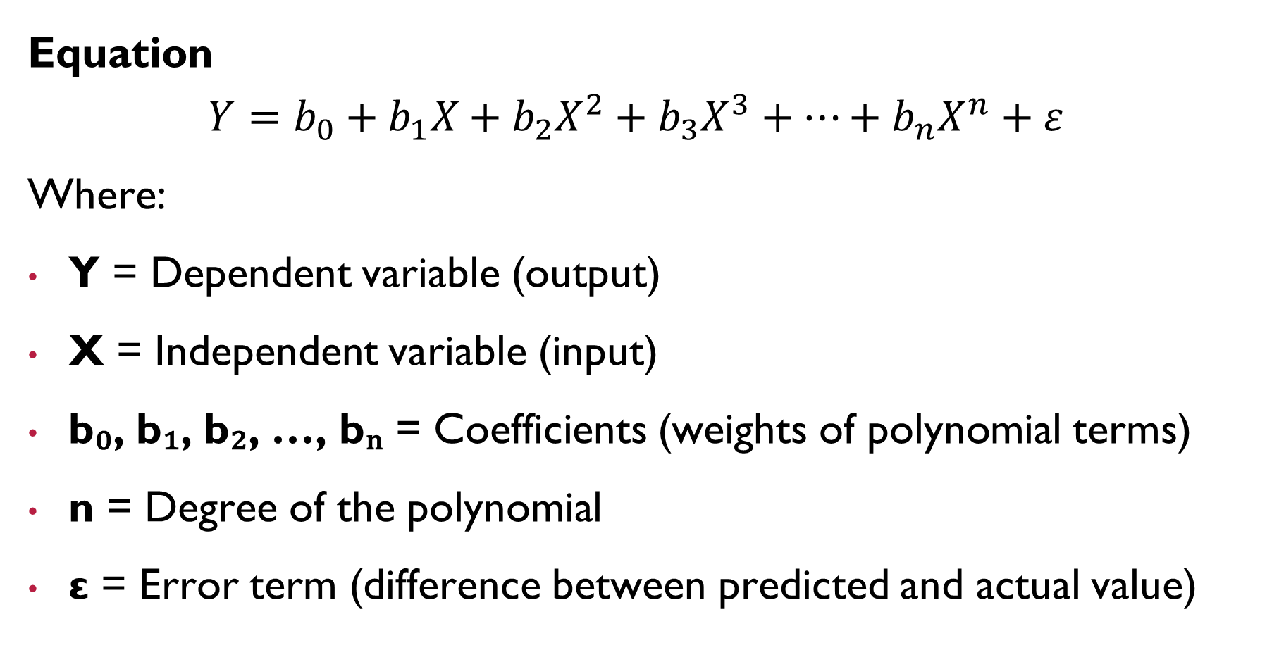

Slide 23
How It Works
Start with a dataset showing a non-linear relationship between X and Y.
Instead of fitting a straight line, we fit a curve using higher-order powers of X.
Use the Least Squares Method to estimate coefficients b₀, b₁, b₂, … that minimize the error.
The degree of the polynomial (n) is chosen based on how curved the data is.

Slide 24
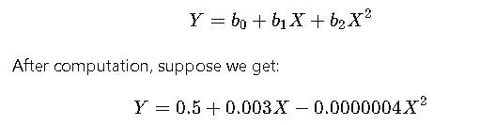
Engine Speed (RPM) | Fuel Consumption (L/hr)
1000 | 3.0
1500 | 4.2
2000 | 5.0
2500 | 6.3
3000 | 6.8
Objective: Predict fuel consumption (Y) based on engine speed (X).
If the relationship between speed and fuel consumption is non-linear, a linear model will not fit properly. We use Polynomial Regression (say, degree 2):
This gives a parabolic curve, showing that after a certain speed, the rate of increase in fuel consumption slows down.

Slide 25
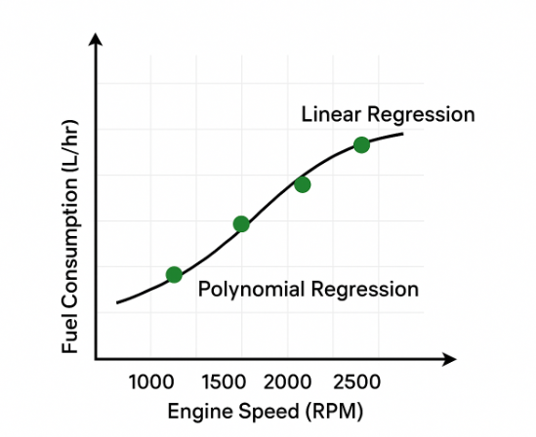
Graphical Representation
The regression curve can be a parabola (degree 2), cubic curve (degree 3), or higher order.
It captures bends and turns in the data, unlike linear regression which is just a straight line.
Visual Example:
Linear Regression → straight line
Polynomial Regression → smooth curved line

Slide 26
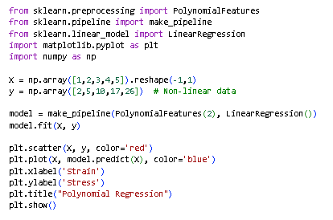
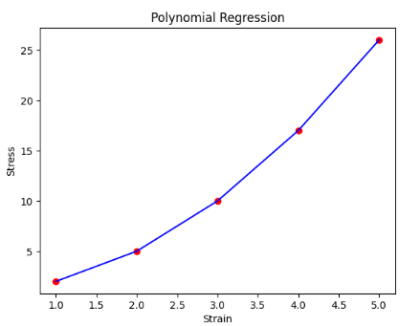

Slide 27
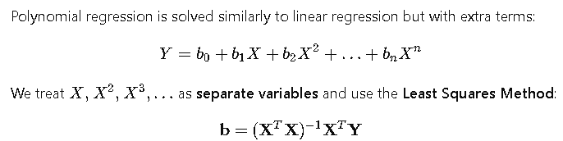
Estimation of Coefficients

Slide 28
Advantages
Can model non-linear and curved relationships.
Provides better fit for real-world data where trends are not straight lines.
Easy to implement and interpret for small datasets.
Limitations
High-degree polynomials can overfit the data (fit noise instead of the pattern).
Extrapolation (predicting outside the dataset) can be unreliable.
Requires careful choice of polynomial degree.

Slide 29
Applications in Mechanical Engineering
Predicting engine efficiency with respect to speed or load.
Modeling stress-strain relationships in materials (non-linear).
Estimating temperature variation with time in a heating process.
Curve fitting for experimental data in thermodynamics and fluid mechanics.

Slide 30
Logistic Regression
Logistic Regression is a classification algorithm used when the output (dependent variable) is categorical, not continuous. It predicts the probability of an event occurring — usually for binary outcomes such as Yes/No, Pass/Fail, Defective/Non-Defective, etc.
Although its name includes “regression,” it is actually used for classification tasks, not for predicting continuous numbers.

Slide 31
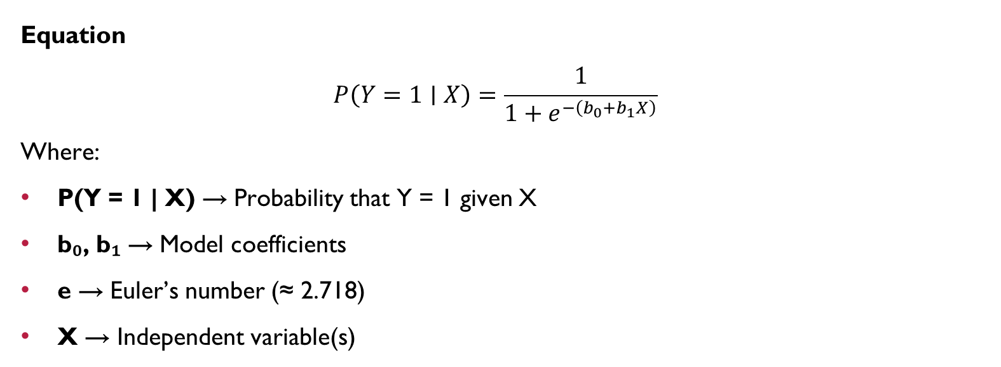
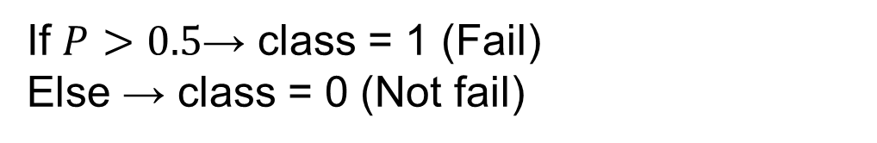

Slide 32
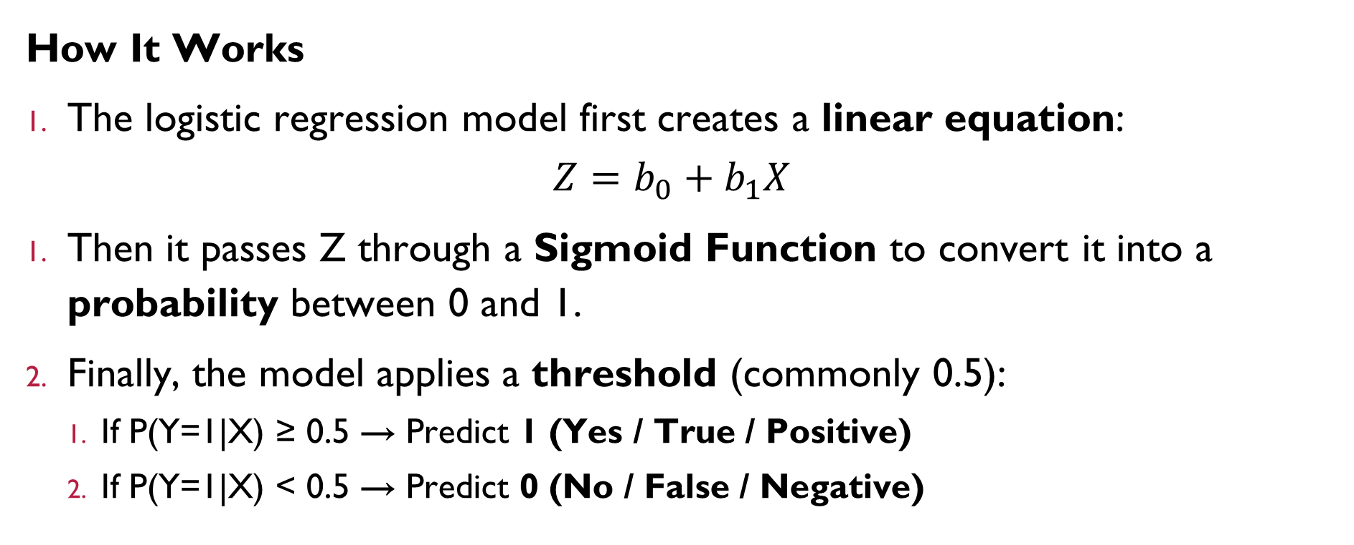

Slide 33
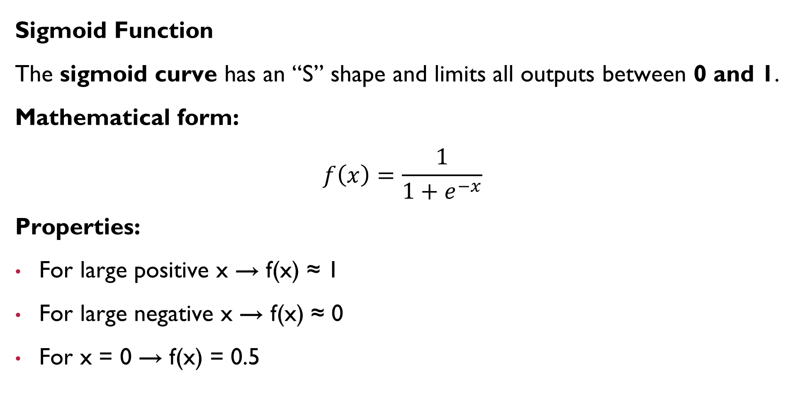

Slide 34
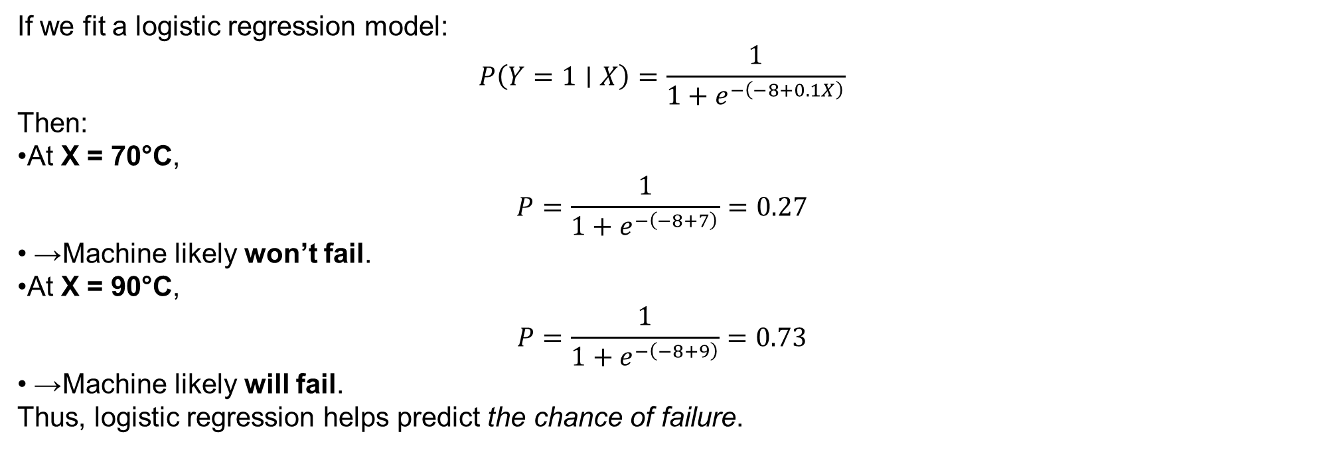
Temperature (°C) | Failure (1 = Yes, 0 = No)
60 | 0
70 | 0
80 | 1
90 | 1
Example
Objective: Predict whether a machine will fail (1) or not fail (0) based on its operating temperature.

Slide 35
Decision Boundary
In logistic regression, we define a cutoff (threshold) to classify outcomes:
If probability ≥ 0.5 → Class = 1
If probability < 0.5 → Class = 0
This creates a decision boundary separating the two classes.
Estimation of Coefficients
Unlike linear regression, logistic regression coefficients are estimated using:
Maximum Likelihood Estimation (MLE) This method finds the best coefficients (b₀, b₁, …) that maximize the probability of correctly predicting the observed data.

Slide 36
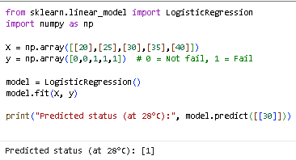
Explanation: The model classifies whether the machine will fail or not based on input temperature.

Slide 37
Advantages
Works well for binary classification problems.
Outputs probabilities, which provide more information than simple yes/no.
Computationally efficient and interpretable.
Limitations
Can only handle linear relationships between independent variables and log-odds of outcome.
Not suitable for highly complex non-linear data.
Requires a large dataset for accurate estimation.

Slide 38
Applications in Mechanical Engineering
Predicting whether a component will fail under given stress/load conditions.
Classifying products as defective or non-defective based on sensor data.
Predicting maintenance requirement (Yes/No) for machines.
Estimating tool wear (Acceptable / Replace) in machining operations.

Slide 39
Support Vector Machines (SVM)
A Support Vector Machine (SVM) is a supervised learning algorithm used for classification and sometimes regression problems. that separates data into classes using a boundary line (hyperplane).
Example: Classify defective (1) vs non-defective (0) parts.
It works by finding the best possible boundary (called a hyperplane) that separates data points of different classes.
SVM aims to maximize the margin — the distance between the hyperplane and the nearest data points from each class.
These closest data points are called Support Vectors.

Slide 40
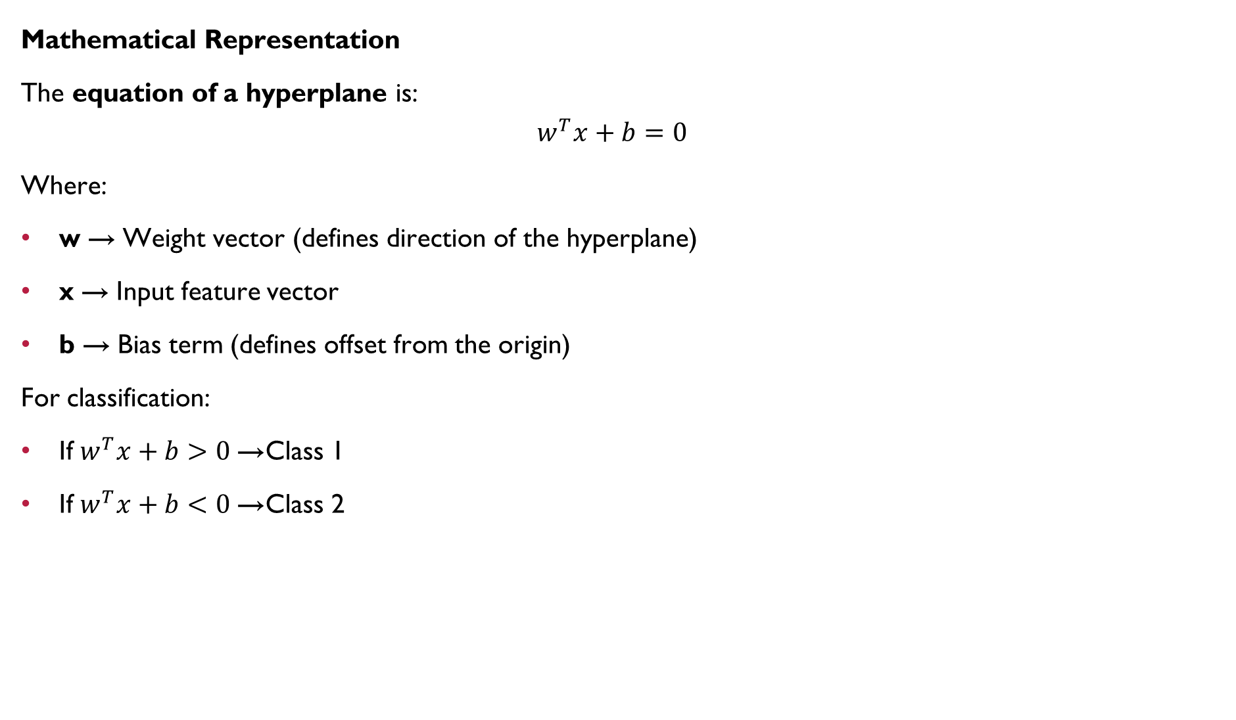

Slide 41
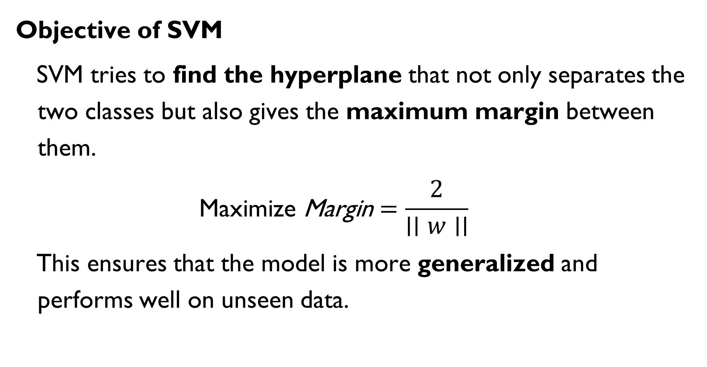

Slide 42
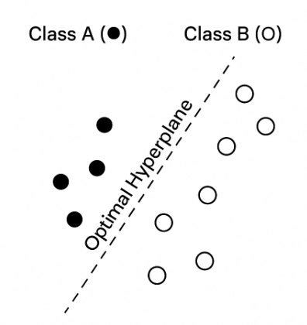
The hyperplane separates two classes with maximum margin. The points closest to the hyperplane are Support Vectors.

Slide 43
What is a Margin?
The margin is the distance between the hyperplane and the nearest data points (support vectors).
Wider margins lead to better classification and less overfitting.
Support Vectors
Support Vectors are the most critical data points that are closest to the decision boundary. They determine the position and orientation of the hyperplane.
If any support vector is removed, the hyperplane changes — that’s why they are “supporting” vectors.

Slide 44
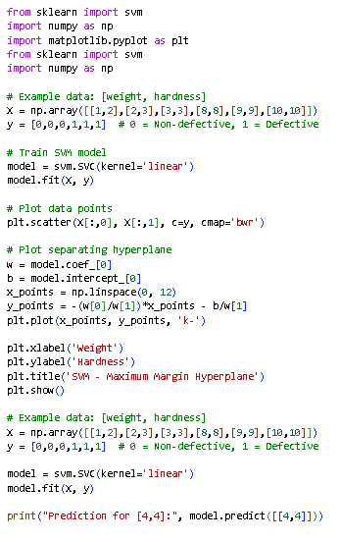
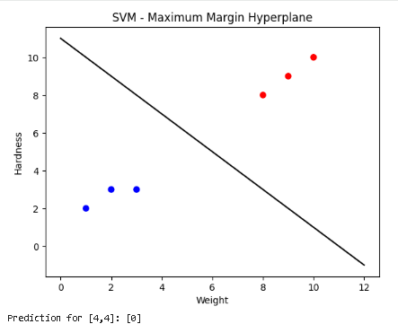

Slide 45
Example (Mechanical Engineering Context)
Imagine you are classifying metal parts as Defective (1) or Non-Defective (0) based on two parameters:
Surface Roughness
Hardness
SVM will plot these points on a graph and find the best straight line (or hyperplane) that separates the two groups clearly.
If the data are well separated, it’s called a Linear SVM. If not, SVM can transform the data using Kernels to find a non-linear boundary.

Slide 46
Types of SVM
Linear SVM
Used when data is linearly separable.
Decision boundary is a straight line (in 2D) or plane (in 3D).
Non-Linear SVM
Used when data cannot be separated linearly.
SVM uses Kernel Functions to transform data into higher dimensions to make separation possible.

Slide 47
Applications (Mechanical Engineering)
Predicting whether a machine part will fail or not based on operational data.
Classifying materials based on tensile strength and hardness.
Sorting products as defective or non-defective from sensor readings.
Identifying machine vibration patterns as normal or abnormal.
Advantages
Works well for high-dimensional data.
Performs effectively when there’s a clear margin of separation.
Robust to overfitting (especially with regularization).
Supports non-linear classification with kernel functions.
Limitations
Performance drops when dataset has overlapping classes.
Training time is longer for large datasets.
Requires careful selection of kernel and parameters.
Difficult to interpret compared to simple models like logistic regression.

Slide 48
Decision Trees
Definition: Decision Trees are flowchart-like structures used for both classification and regression tasks.
They divide the dataset into smaller subsets based on feature values and make decisions at each node.

Slide 49
Working Principle:
The tree starts with a root node representing the entire dataset.
At each internal node, data is split based on the feature that gives the best separation (using metrics like Gini Index, Entropy, or Information Gain).
The process continues recursively until a stopping condition is reached.
Leaf nodes represent the final decision or output value.

Slide 50
Advantages:
Easy to understand and visualize.
Works for both numerical and categorical data.
Requires less data preprocessing (no need for feature scaling).
Disadvantages:
Can easily overfit the data if not pruned properly.
Small changes in data can lead to a different tree structure.
Example: Predicting whether a customer will purchase a product based on income and age.

Slide 51
Important Terms in Decision Trees
1. Root Node:
Represents the entire dataset.It is the starting point of the decision tree.
The dataset is split from this node based on the most significant attribute.
2. Branch:
Each branch represents the outcome of a decision or test condition.
It connects nodes and shows the path taken for classification or regression.
3. Leaf Node (Terminal Node):
Represents the final decision or prediction.No further splitting occurs from this node.
Each leaf corresponds to a class label (for classification) or a numerical value (for regression).
4. Splitting:
The process of dividing the dataset into smaller subsets based on a condition or feature value.
Splitting continues recursively until a stopping criterion (like minimum samples or maximum depth) is reached.

Slide 52
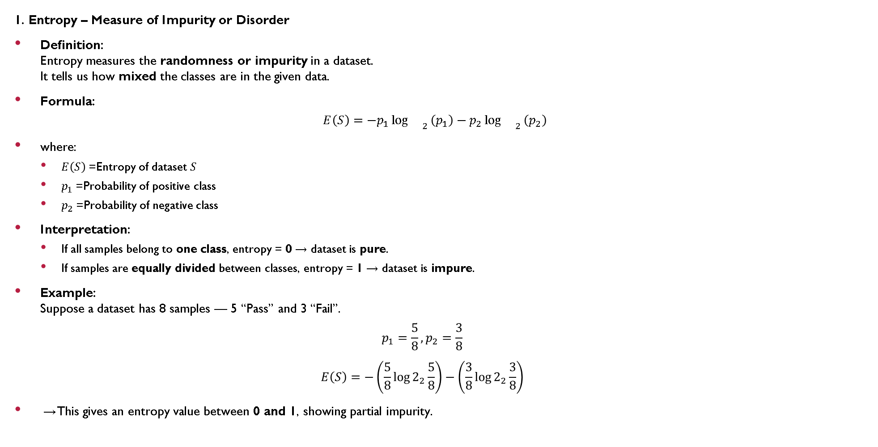
Entropy and Information Gain

Slide 53
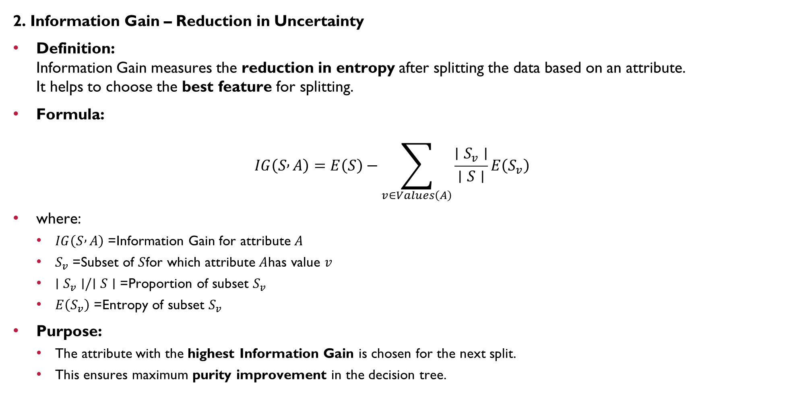

Slide 54
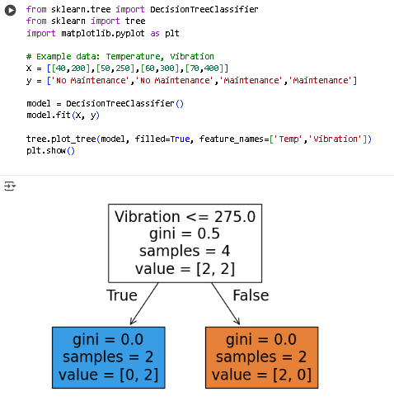

Slide 55
Decision Tree Algorithms
Decision Tree algorithms are methods used to build decision trees automatically from data. They decide which features to split and how deep the tree should go, using mathematical measures like Information Gain or Gini Index.
Two popular Decision Tree algorithms are ID3 and Random Forest.

Slide 56
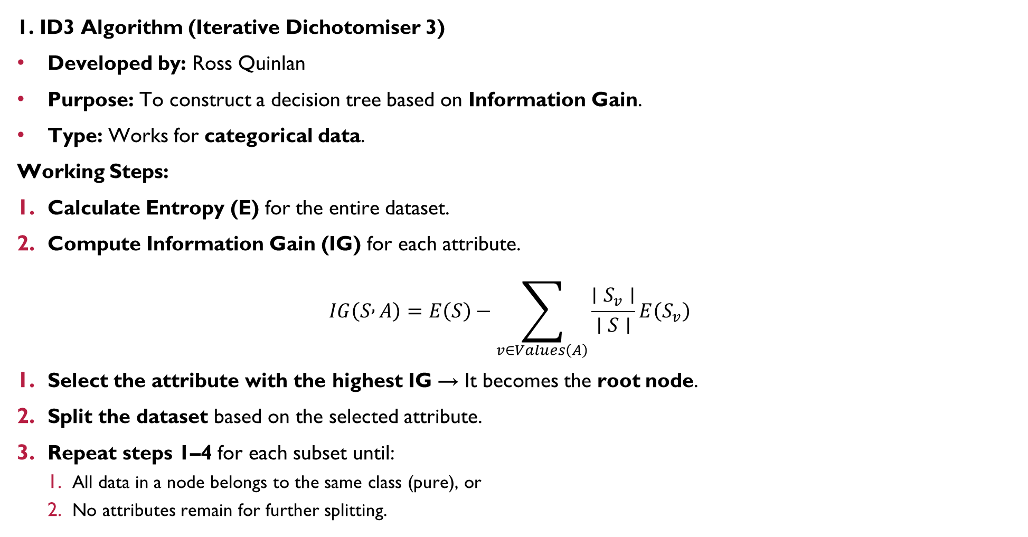

Slide 57
Advantages:
Simple and easy to understand.
Fast for small datasets.
Limitations:
Works best with categorical data only.
Can overfit (become too specific) if not controlled.
Example (Mechanical Context):
Predicting whether a machine needs maintenance based on:
Vibration Level (Low/High)
Temperature (Normal/High)
Noise (Low/High)
The ID3 algorithm selects the attribute giving maximum Information Gain at each split.

Slide 58
Random Forest Algorithm
Definition: Random Forest is an ensemble method that combines multiple decision trees to improve prediction accuracy. It is used for both classification and regression tasks.
Concept: Instead of using one tree, Random Forest builds many trees using random subsets of data and features. The final prediction is made by majority voting (for classification) or average prediction (for regression).
Steps:
Select random samples from the dataset.
Build a decision tree for each sample.
Repeat the process to create many trees (e.g., 100 trees).
Combine all tree outputs:
Classification: Take the majority vote.
Regression: Take the average of all predictions.

Slide 59
Advantages:
Reduces overfitting compared to a single decision tree.
Works well with large datasets.
Handles missing values effectively.
Disadvantages:
Slower than a single decision tree.
More complex to interpret.
Example :
Predicting tool wear level using multiple factors — temperature, vibration, spindle speed, and feed rate. Random Forest combines multiple trees to make a more reliable prediction.

Slide 60
Evaluation Metrics
In Machine Learning classification models, we use various evaluation metrics to check how well the model performs on unseen data.
These metrics help measure how accurately the model predicts the correct class labels (for example — Pass/Fail, Defective/Non-defective, Yes/No).

Slide 61
Actual \ Predicted | Positive | Negative
Positive | True Positive (TP) | False Negative (FN)
Negative | False Positive (FP) | True Negative (TN)
Confusion Matrix
Before understanding the metrics, we must know the Confusion Matrix, which summarizes the prediction results.
TP (True Positive): Model correctly predicts the positive class.
TN (True Negative): Model correctly predicts the negative class.
FP (False Positive): Model predicts positive when it’s actually negative (Type I error).
FN (False Negative): Model predicts negative when it’s actually positive (Type II error).

Slide 62
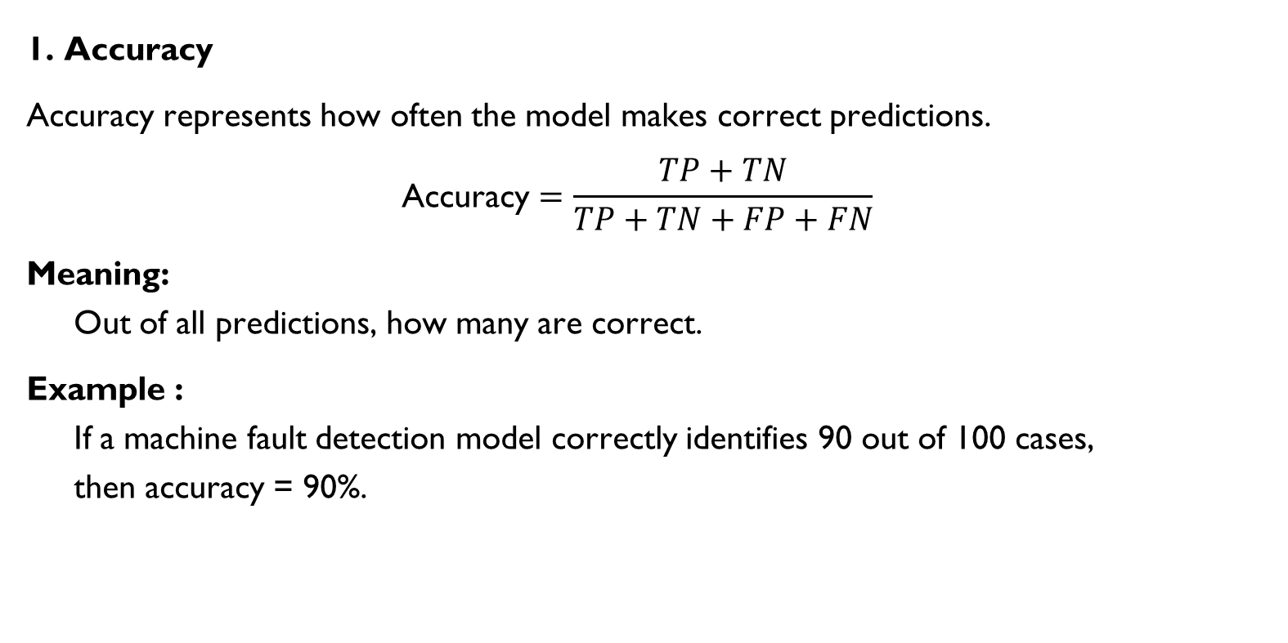

Slide 63
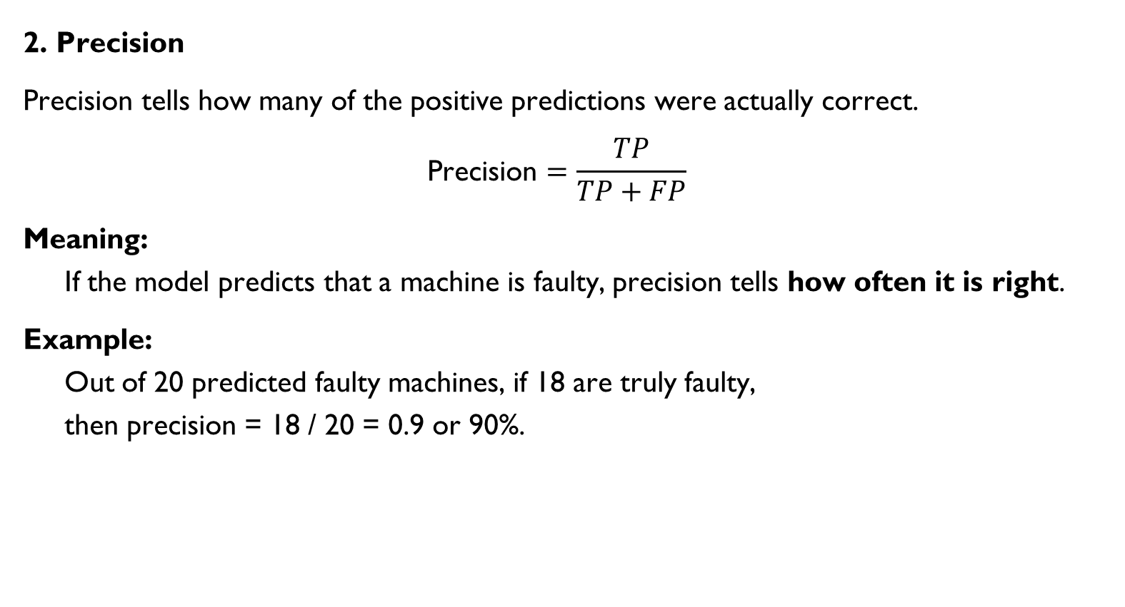

Slide 64
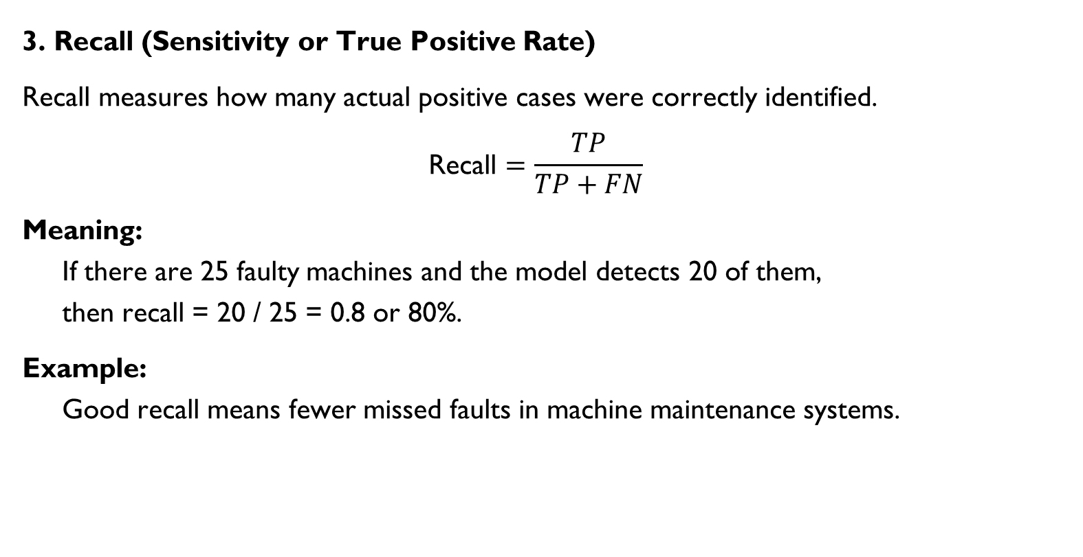

Slide 65
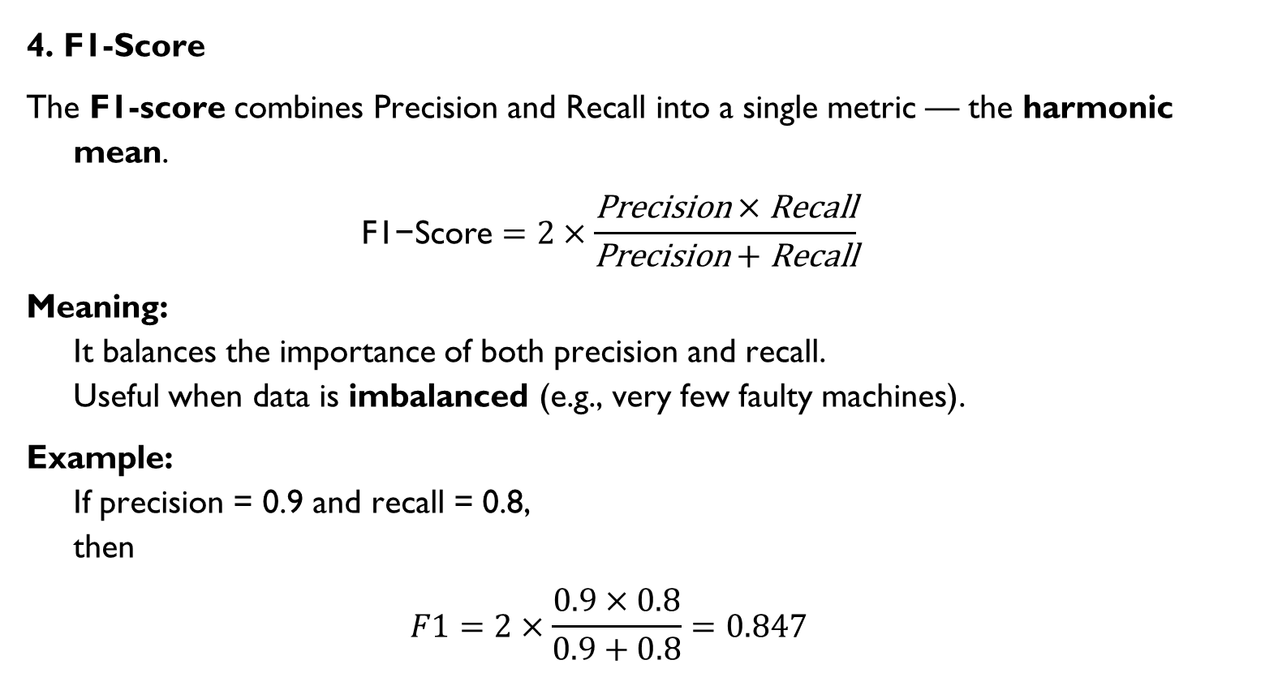

Slide 66
Summary
Metric | Formula | Interpretation | Ideal Value
Accuracy | (TP + TN) / (TP + TN + FP + FN) | Overall correctness | High
Precision | TP / (TP + FP) | Correctness of positive predictions | High
Recall | TP / (TP + FN) | Ability to find all positive cases | High
F1-Score | 2 × (Precision × Recall) / (Precision + Recall) | Balance between precision & recall | High

Slide 67
Mechanical Example Recap
In a machine fault classification system:
Precision tells how many detected faults are real.
Recall tells how many actual faults are detected.
Accuracy shows overall correctness.
F1-score provides a balanced view of performance.

Slide 68
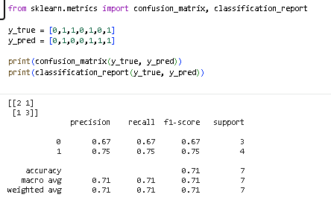

Slide 69
Cross Validation
Cross-validation is used to test the performance of a model by splitting the data into multiple parts (folds).
In Machine Learning, after training a model, we must check how well it performs on unseen data. If we train and test on the same data, the model may memorize instead of learning — this problem is called overfitting.
To solve this, we use Cross Validation — a statistical method to test the performance and reliability of a model.

Slide 70
Definition
Cross Validation is a technique used to evaluate a machine learning model’s performance by splitting the data into multiple parts and testing the model on different subsets.
It helps ensure that the model:
Performs well on unseen data,
Is not overfitted or underfitted,
Gives stable and accurate predictions.

Slide 71
Working Principle
Divide the entire dataset into two parts:
Training Set → used to train the model.
Testing Set → used to check model performance.
Cross-validation repeats this process multiple times with different splits to ensure reliable results.

Slide 72
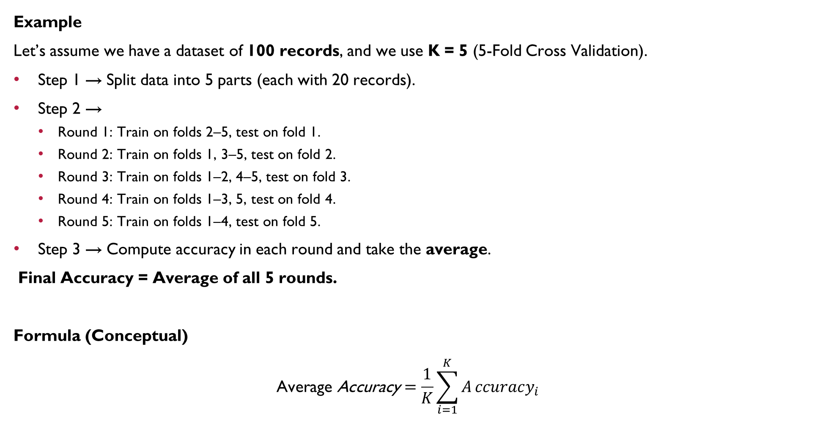

Slide 73
K-Fold Cross Validation
It is the most common type of cross-validation.
Step-by-step process:
Split the dataset into K equal parts (folds).
For each iteration:
Use K−1 folds for training.
Use 1 fold for testing.
Repeat this K times, changing the test fold each time.
Finally, take the average accuracy from all K tests — this gives the final performance score.

Slide 74
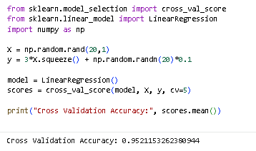

Slide 75
Advantages
Gives a more accurate estimate of model performance.
Reduces the risk of overfitting.
Makes use of the entire dataset for both training and testing.
Limitations
Increases computational cost (model trains multiple times).
Not suitable for very large datasets if computation power is limited.
Types of Cross Validation
K-Fold Cross Validation → Most commonly used.
Leave-One-Out (LOOCV) → Each data point is tested once; very accurate but slow.
Stratified K-Fold → Keeps class proportions same in all folds (useful for classification).
Repeated K-Fold → Repeats K-fold multiple times for better reliability.

Slide 76
Example
Suppose we build a regression model to predict engine fuel consumption based on speed, temperature, and load. By applying 5-Fold Cross Validation, we train and test the model five times using different subsets of data. If all rounds show similar accuracy, it means the model is stable and reliable.

Slide 77
Key Differences Between Regression and Classification
Feature | Regression | Classification
Output Type | Continuous numeric value | Categorical value
Examples | Predict temperature, pressure, cost, speed | Predict machine fault type, material quality, pass/fail
Algorithms Used | Linear Regression, Polynomial Regression, Decision Tree Regression | Logistic Regression, SVM, Decision Trees, Random Forest
Error Measure | Mean Squared Error (MSE), RMSE | Accuracy, Precision, Recall, F1-score
Graph Output | Line or curve fit through data | Decision boundary between classes
Application in Mechanical Engg. | Predicting torque, stress, or performance efficiency | Classifying defect type, fault detection, quality grading

Slide 78
Real-Life Mechanical Examples
Regression Example:
Problem: Predict fuel consumption (L/hr) of an engine based on speed (RPM) and load (kg).
Output: A numeric value → e.g., 5.4 L/hr.
Classification Example:
Problem: Predict whether a gearbox is normal (0) or faulty (1) based on vibration and temperature data.
Output: A class label → “Faulty” or “Normal.”

Slide 79
Question Bank-Unit-5
Explain simple and multiple linear regression and discuss how they can be applied to predict mechanical parameters like material strength or fuel consumption.
Describe the assumptions of linear regression and analyze how violating these assumptions affects prediction accuracy in mechanical datasets.
Explain decision trees with relevant terminology and discuss their advantages, limitations, and applications in mechanical fault diagnosis.
Compare logistic regression and SVM for classification tasks such as equipment failure prediction in mechanical systems.
Describe Random Forest and evaluate how cross-validation improves the reliability of machine-learning models in mechanical engineering applications.
What is polynomial regression? Explain how it can model nonlinear mechanical relationships such as stress–strain behaviour.
Define a confusion matrix and explain how precision and recall help assess the performance of fault detection models.
Briefly explain decision tree algorithms like ID3 and Random Forest and give one mechanical application.
What are the common problems in decision trees? Mention how they affect prediction quality.
Explain how logistic regression works and give one example of its use in mechanical system classification.

Slide 80
Question Bank-Unit-6
Explain how machine learning can be used for predictive maintenance in mechanical systems such as motors, pumps, or turbines.
Describe the role of machine learning in automated quality control and defect detection in manufacturing processes.
“How can machine learning assist in optimizing mechanical design parameters (e.g., weight reduction, material selection)?
Discuss how machine learning enhances robotics and automation in mechanical engineering applications such as assembly lines.
Summarize one real-world research application where machine learning is used in mechanical engineering (e.g., vibration analysis, heat transfer prediction).

Slide 81
https://kitcoek.webex.com/meet/shah.sujeeta

